Slide 1
United Way Presentation

Slide 2
Objective
Reproduce what Vincent had done in his excel sheet in R, so United way could build a model with Forio.com
New Goal: create a Rshiny/Forio website that optimizes child well being give user inputted bounds

Slide 3
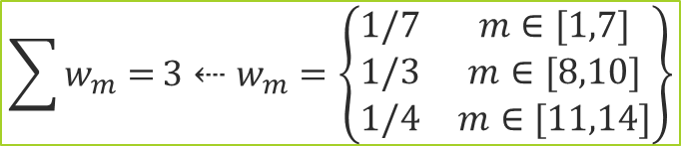
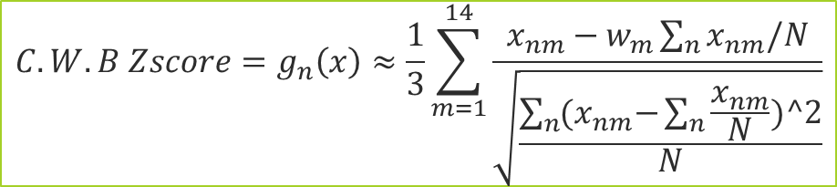
Method: Standardize
What united way wants to do when they make an index is basically standardize all the variables and do a weighted average them in a certain order.
https://en.wikipedia.org/wiki/Index_(statistics)
https://en.wikipedia.org/wiki/Human_Development_Index an example
https://en.wikipedia.org/wiki/Dow_Jones_Industrial_Average
Indexes help us rank and measure statistics
N= the total number of census tracts (rows in data) x= the actual variable data per row/column w= the weight n=row # m=column #
$$C.W.B Zscore=g_{n}\left(x\right)≈\frac{1}{3}\sum_{m=1}^{14}{\frac{x_{nm}−w_{m}\sum_{n}{x_{nm}/N}}{\sqrt{\frac{\sum_{n}{{(x}_{nm}−\sum_{n}{\frac{x_{nm}}{N}})^2}}{N}}}}$$
$$\sum{w_{m}=}3⇠w_{m}=\left\{\begin{matrix}1/7 & m∈[1,7] \\ 1/3 & m∈[8,10] \\ 1/4 & m∈[11,14]\end{matrix}\right\}$$
Notes:
Above is the closed form solution for Child Well being index Z-score. It is a weighted average. Each of the 3 similar weights are the 3 sub-indexes—Child Sub-index, Family Sub-index, and Community Sub-index in that order

Slide 4
Methods: Steps
Create a workable way to calculating the old Child Wellbeing Index, so we can integrate in Forio and create a visual model:
Calculate Mean and Population Deviation
Core Algorithm: Do Z-Score
Adjust it so that it is only between -3.1 and 3.1 Add the z-scores in order in listed order and divide by the amounts
Turn things that should be negative to actual negative
Calculate the Child, Family, and Community Sub-Index
CWI = Average the 3 sub indices
Rescale them from 1-100
Quintiles are calculated

Slide 5
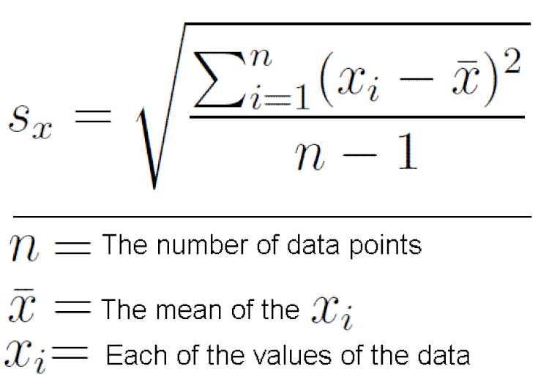
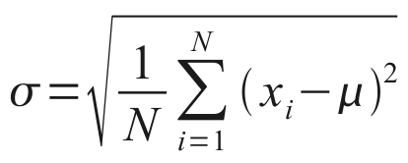

Methods: Calculate the z-score
The basic formula normally for Z-score is:
$\frac{an x−value – mean(x)}{standard deviation(x) }$ a value in x – its mean / deviation(x)
We are not using standard deviation. We are using population deviation
Standard Deviation Population Deviation
Notes:
Within these steps we need to briefly talk about a correction we had to use to Z-score

Slide 6
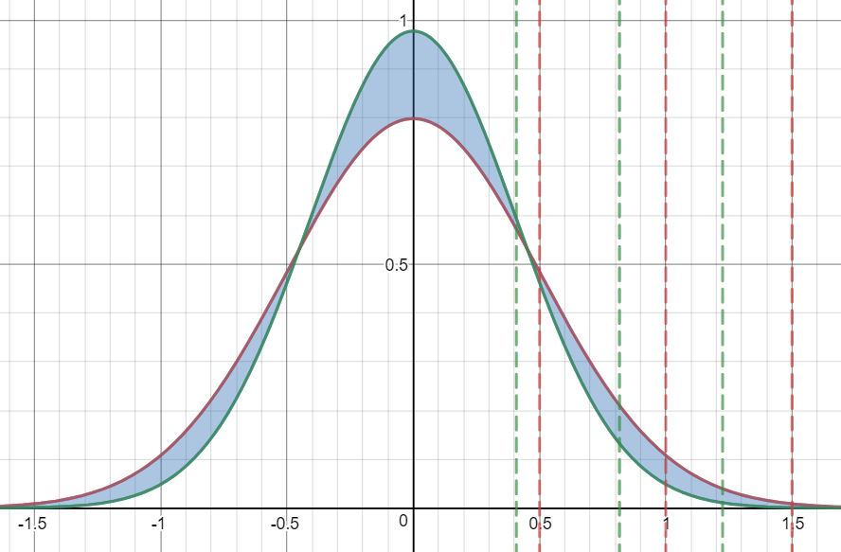


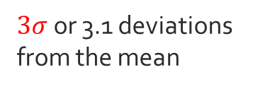


Methods: Correction Factor sample deviation VS population deviation or p:
We just need to multiply by the
$$\sqrt{\frac{n−1}{n}}$$
$$\sqrt{\frac{n−1}{n}}$$
$3σ$ or 3.1 deviations from the mean
$$σ$$
$$2σ$$
Notes:
http://stats.seandolinar.com/calculating-z-scores-with-r/
https://stackoverflow.com/questions/6263400/can-i-calculate-z-score-with-r
Or just take the equations for standard deviation and population deviation and compare them….
X = standard deviation/population deviation

Slide 7

methods
$$\sqrt{\frac{n−1}{n}}$$
Do the step but with the Correction factor:
Plots: then we plotted our results
We then created box plots, histograms, and quintiles of the Z-scores, and Indexs as we will show in our results.
We found that box plots really don’t work
Because 4 segments and quintiles are for 5
Because visually the lower end of the data is underrepresented in any separation less than 5

Slide 8
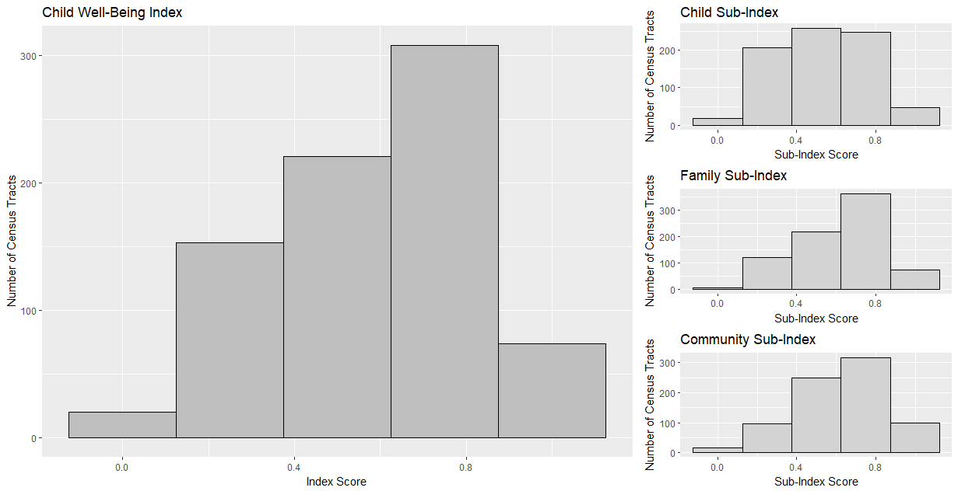
Results: Barplots

Slide 9
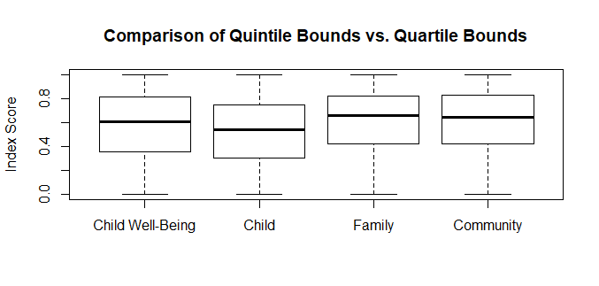
Results: Box-Plots
Notes:
These were not effective

Slide 10
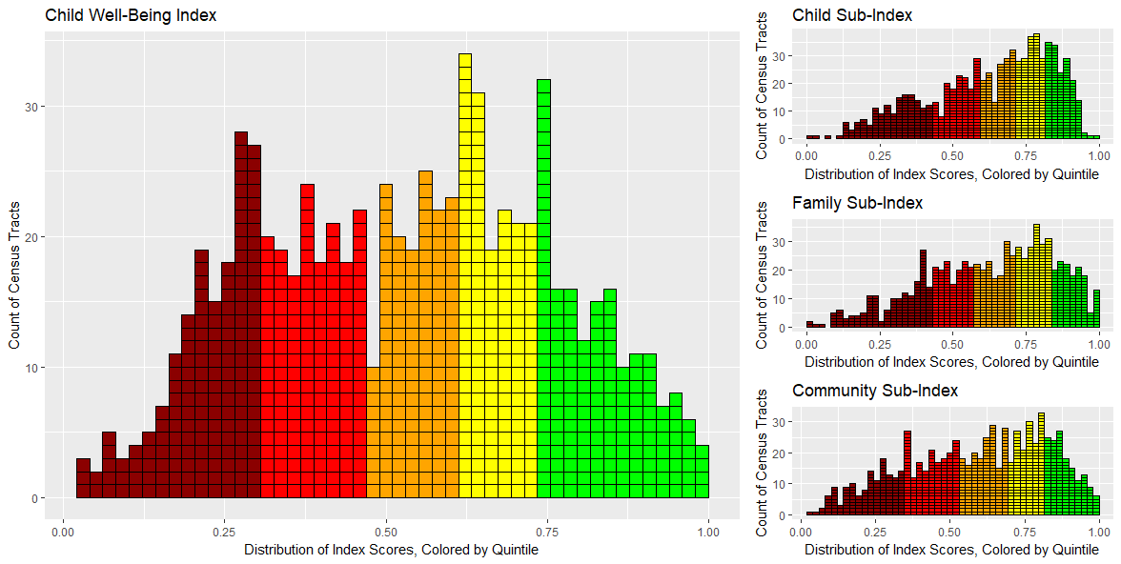
Results: Histogram Plot

Slide 11
Results: Histogram Plot

Slide 12
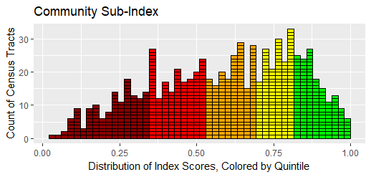
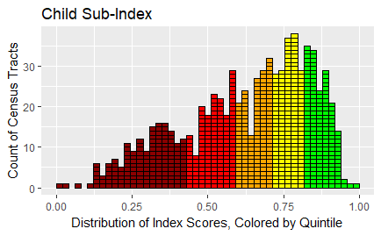
Results: SUB-indices
Community Sub-index
Child Sub-index

Slide 13
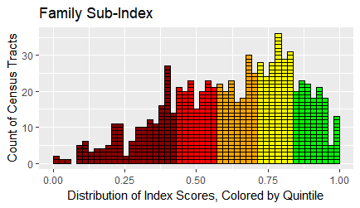
Results: SUB-indices
Community Sub-index
Family Sub-index

Slide 14
Future Exploration
In this analysis we had to correct an error how we calculated Z-scores by using population deviation instead of standard, if united way wants we
Current Deliverable: United way currently want to optimize the calculation of Child Well Being and then create a website to display that
Alternatively, we can use Rshiny

Slide 15
CONTACT TO HELP WITH research
Contacts:
https://github.com/jonstoked/ChildWellBeing
https://github.com/ashtondrew/ChildhoodHunger
https://kdvdecisionanalysis.shinyapps.io/TODD_UWhunger/
Hackathon source: https://ncdata4good.github.io/UWchallenge/

